Slide 1
Cold Start

Slide 2
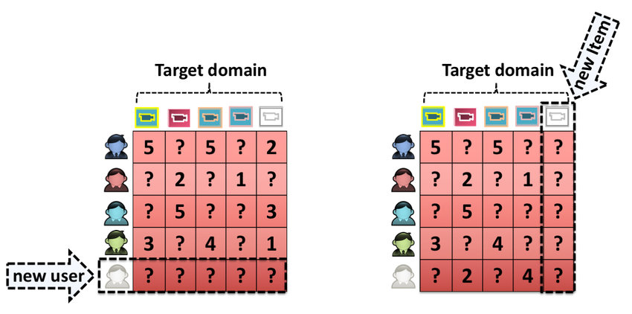
What is Cold Start
S
X
L
New community
Start-up of the recommender
New Item
New Item is added to the system
New User
New Users is registered
Notes:
New community:
refers to the start-up of the recommender, when, although a catalogue of items might exist, almost no users are present and the lack of user interaction makes it very hard to provide reliable recommendations
New item: a new item is added to the system, it might have some content information but no interactions are present
New user: a new user registers and has not provided any interaction yet, therefore it is not possible to provide personalized recommendations

Slide 3
Why is Cold Start A Problem
S
X
L
New Community
Almost no users are present and lack of user interaction
New Item
Have some content but no interaction with users
New user
Not provide any interactions yet
Hard to provide personalized recommendations

Slide 4
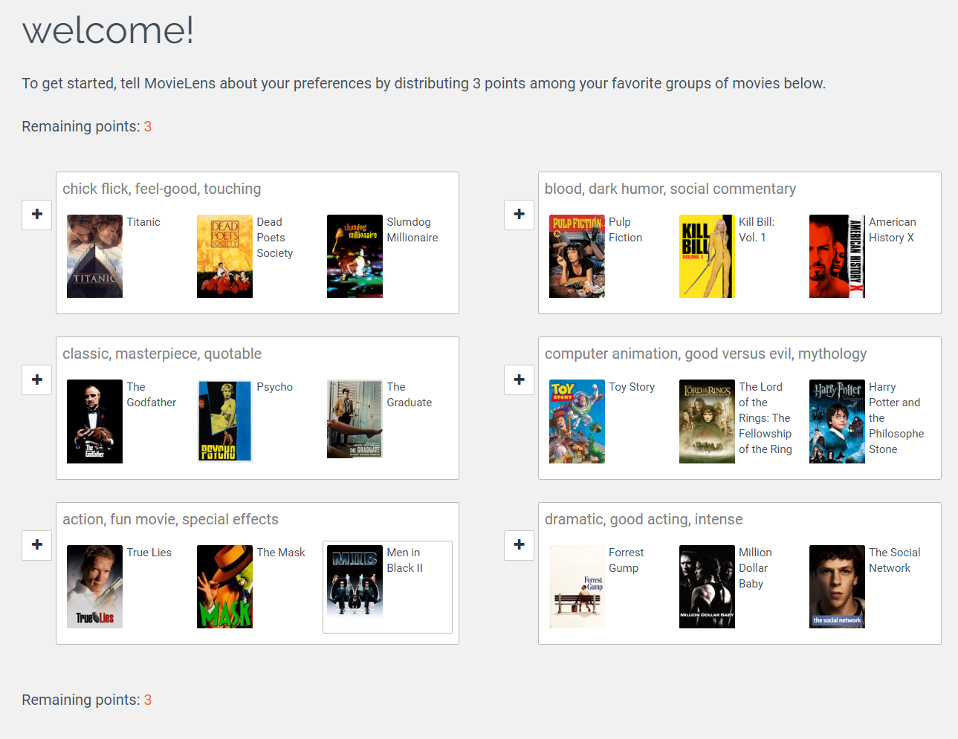
How To Deal With Cold Start
Profile completion (Preference elicitation)
Rapidly acquire some preference data from cold users
For example MovieLens, a web-based recommender system for movies, asks the user to rate some movies as a part of the registration.

Slide 5
How To Deal With Cold Start
S
X
L
Item Cold Start
Content-based filtering is the method that answers this question
User Cold Start
By default, the very first step is to apply a popularity based strategy. Trending products can be determined by global trends and what’s been popular recently, regionally, or at that certain time of the day. Then as a next step, you can narrow the selection of ads you display for visitors by making use of contextual information
Device Cold Start
Geolocating users with either their geoIP or their mobile device’s GPS co-ordinates.
Knowing the referrer (which site the visitor came from), the device (mobile, desktop), the operating system (iOS, Windows, Android) and the browser type (Chrome, IE, Safari, etc) will help with personalizing the ads you display.

Slide 6

Adding Bias in ALS
S
X
L
Applying the dot product of the user and item latent vectors is not accurate
Some users might rate all movies highly
Some movies may tend to always have low ratings
Notes:
Instead of assuming that a user u‘s rating for item i can be described simply by the dot product of the user and item latent vectors, we will consider that each user and item can have a bias term associated with them. The rational is that certain users might tend to rate all movies highly, or certain movies may tend to always have low ratings.

